Slide 1
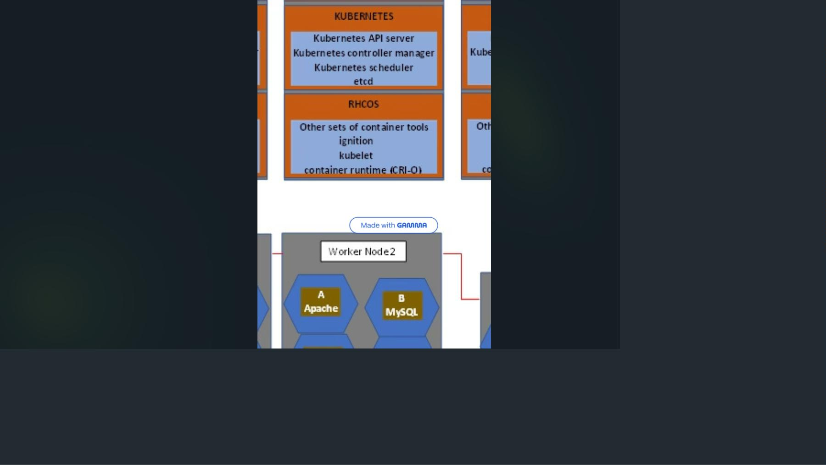
OpenShift:
Container
Application
Platform
Learn what OpenShift is, why it's important, and explore its comprehensive
architecture built on Kubernetes and Red Hat Core OS.

Slide 2
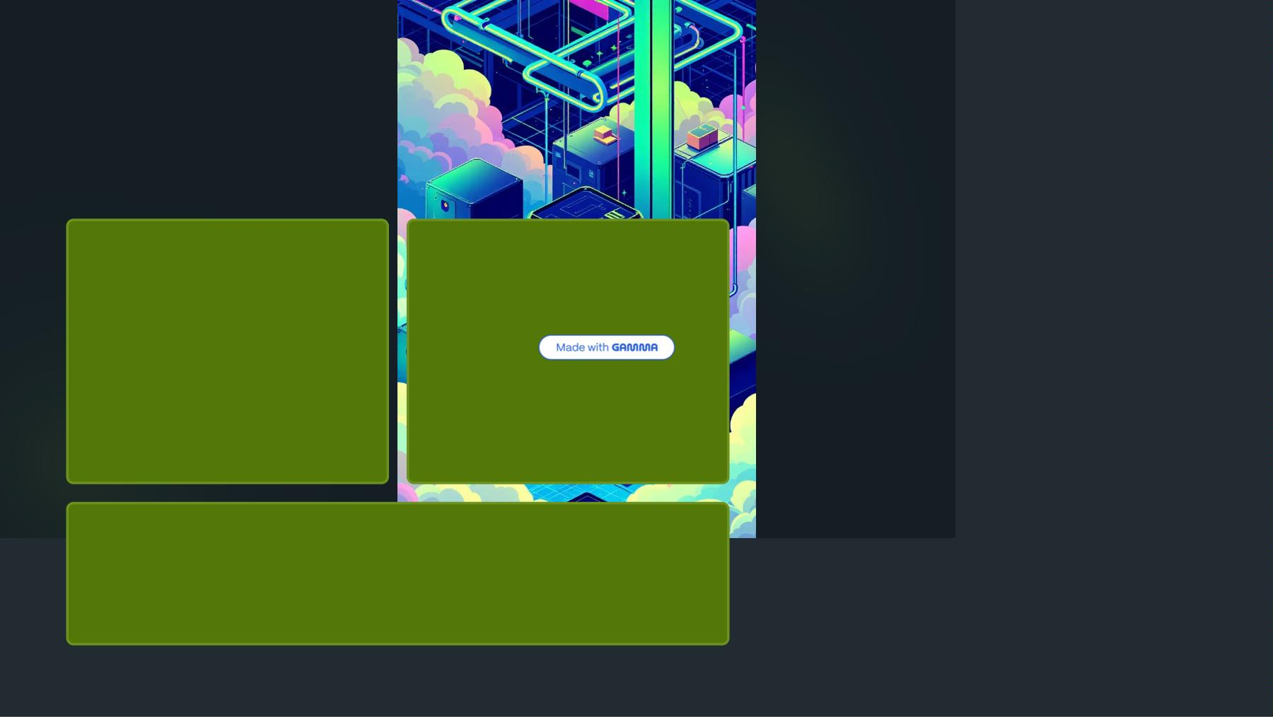
Why OpenShift
Matters
Container
Runtime
Enterprise
Scale
Limitations
Challenge
Docker and Podman work for
basic containers but struggle
with large-scale management.
Managing hundreds or thousands
of containerized applications
requires sophisticated
orchestration.
Mission-Critical Applications
Core banking and heavy enterprise applications demand high availability
and automation.

Slide 3
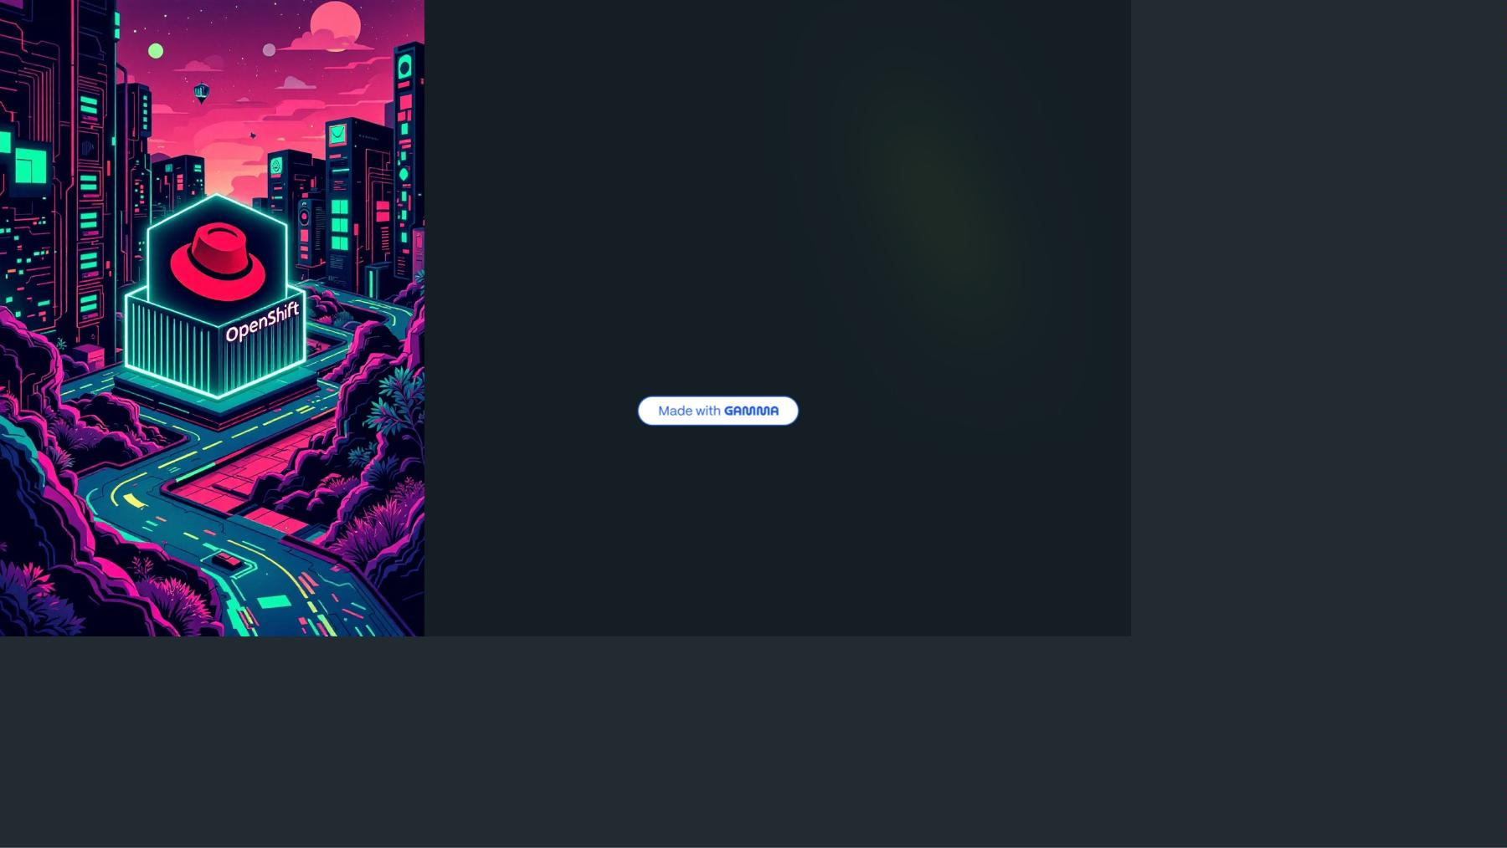
What is
OpenShift?
Container
Application
Platform
Kubernetes
Distribution
Compatible with Kubernetes but
managed through OpenShift-
specific tools.
OpenShift orchestrates and
manages containerized
applications, enabling easy scaling
as required.
Think of OpenShift as a distribution
of Kubernetes with enterprise
features.
Developed by Red Hat, it's built on
top of Kubernetes cluster and Red
Hat Core Operating System.

Slide 4
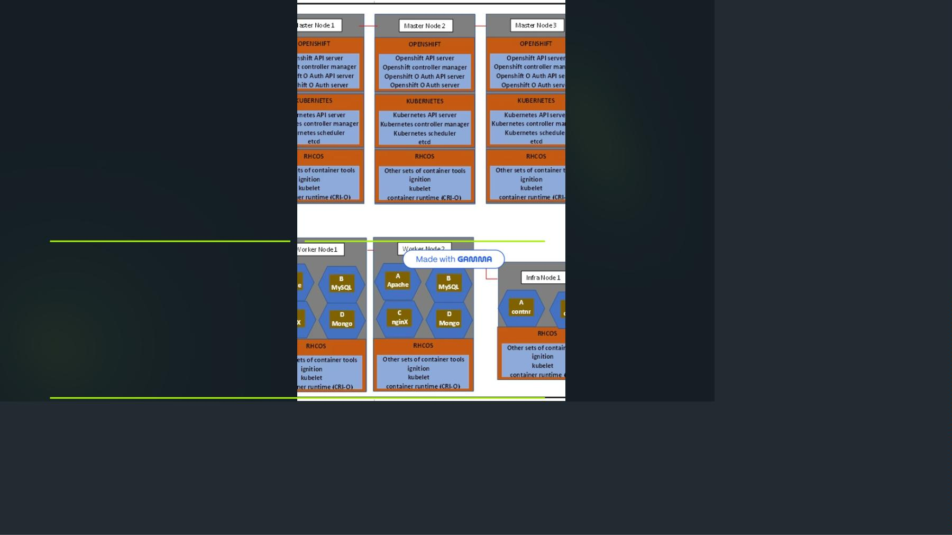
OpenShift
Cluster
Architecture
01
02
Master Nodes
(Control Plane)
Worker Nodes
(Compute)
Provide basic services that manage
the OpenShift cluster operations.
Host your applications and workloads
with more server resources.
03
Infrastructure Nodes
Host infrastructure services like monitoring and logging systems.

Slide 5
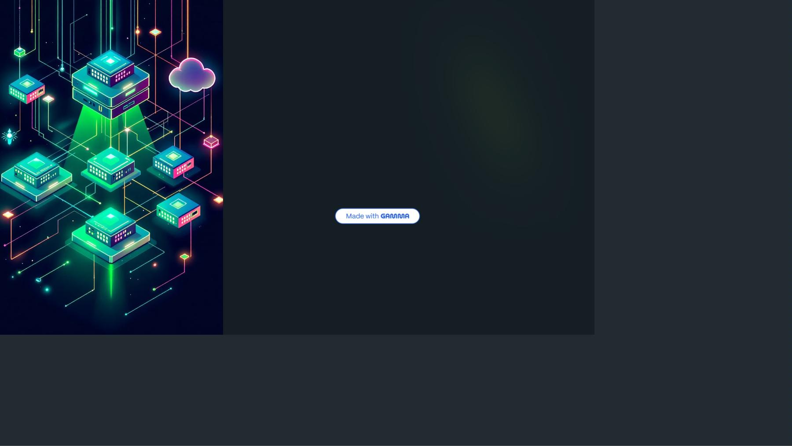
Minimum Cluster
Requirements
3 2
Control Planes
Worker Nodes
Minimum required master nodes for
cluster management
Minimum compute nodes needed for
application workloads

Slide 6
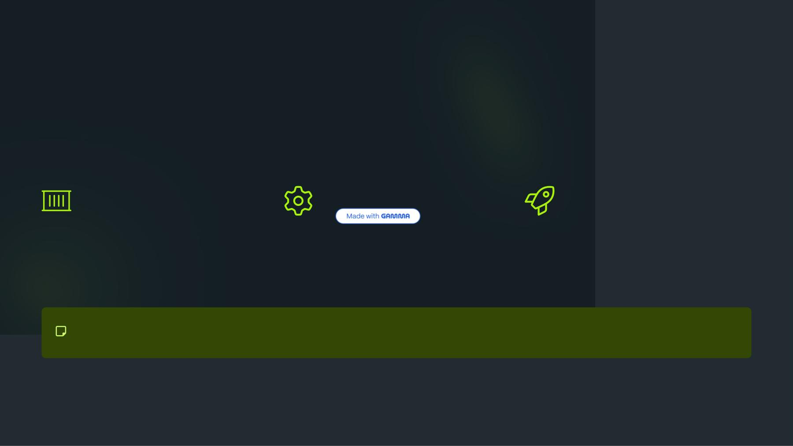
Layer 1: Red Hat Core OS
(RHCOS)
Container-
Optimized OS
Kubelet
Service
Ignition System
First boot system configuration to
bring up and configure the cluster.
Includes CRIO container runtime
(Kubernetes native) replacing
Docker in newer versions.
Interfaces with container runtime,
starts pods, and assigns node
resources.
RHCOS is immutable - no operating system management required, unlike RHEL.

Slide 7
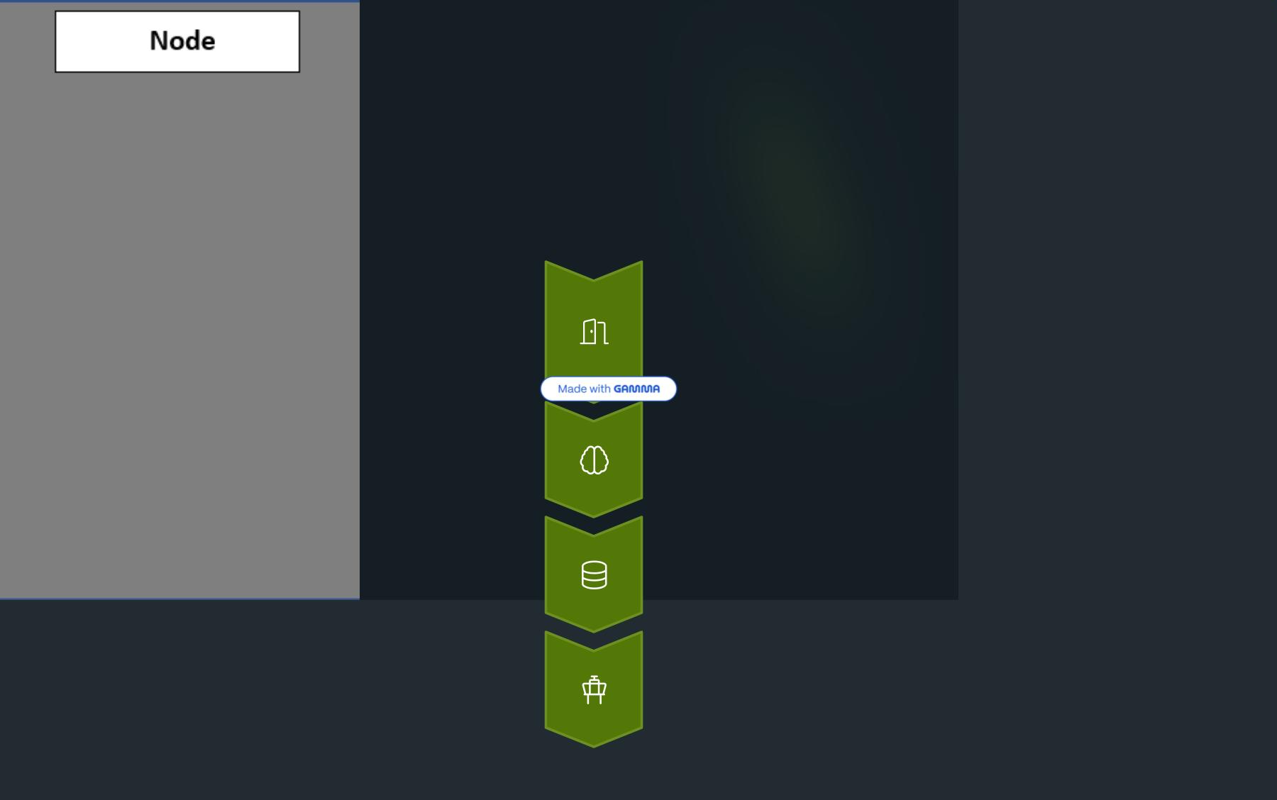
Layer 2:
Kubernetes
Services
Kubernetes API
Gateway to cluster - validates credentials and handles
authentication.
Scheduler
Intelligently schedules pods on appropriate nodes automatically.
etcd
Cluster brain - stores all operations as logs in YAML format.
Controller Manager
Watches etcd, enforces desired state through API calls.

Slide 8
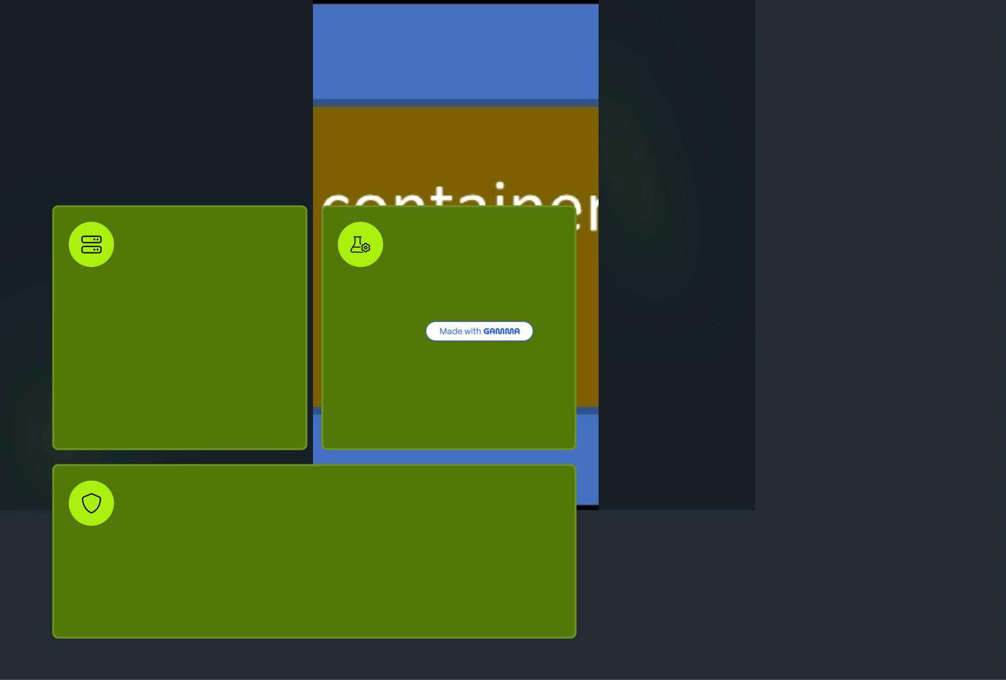
Layer 3:
OpenShift
Services
OpenShift API
Server
OpenShift
Controller
Manager
Validates and configures
OpenShift resources like
Ensures OpenShift objects
maintain desired state by
watching etcd changes.
templates, projects, and routes.
OAuth Authentication
Integrates external authentication methods and manages user tokens for
API access.

Slide 9
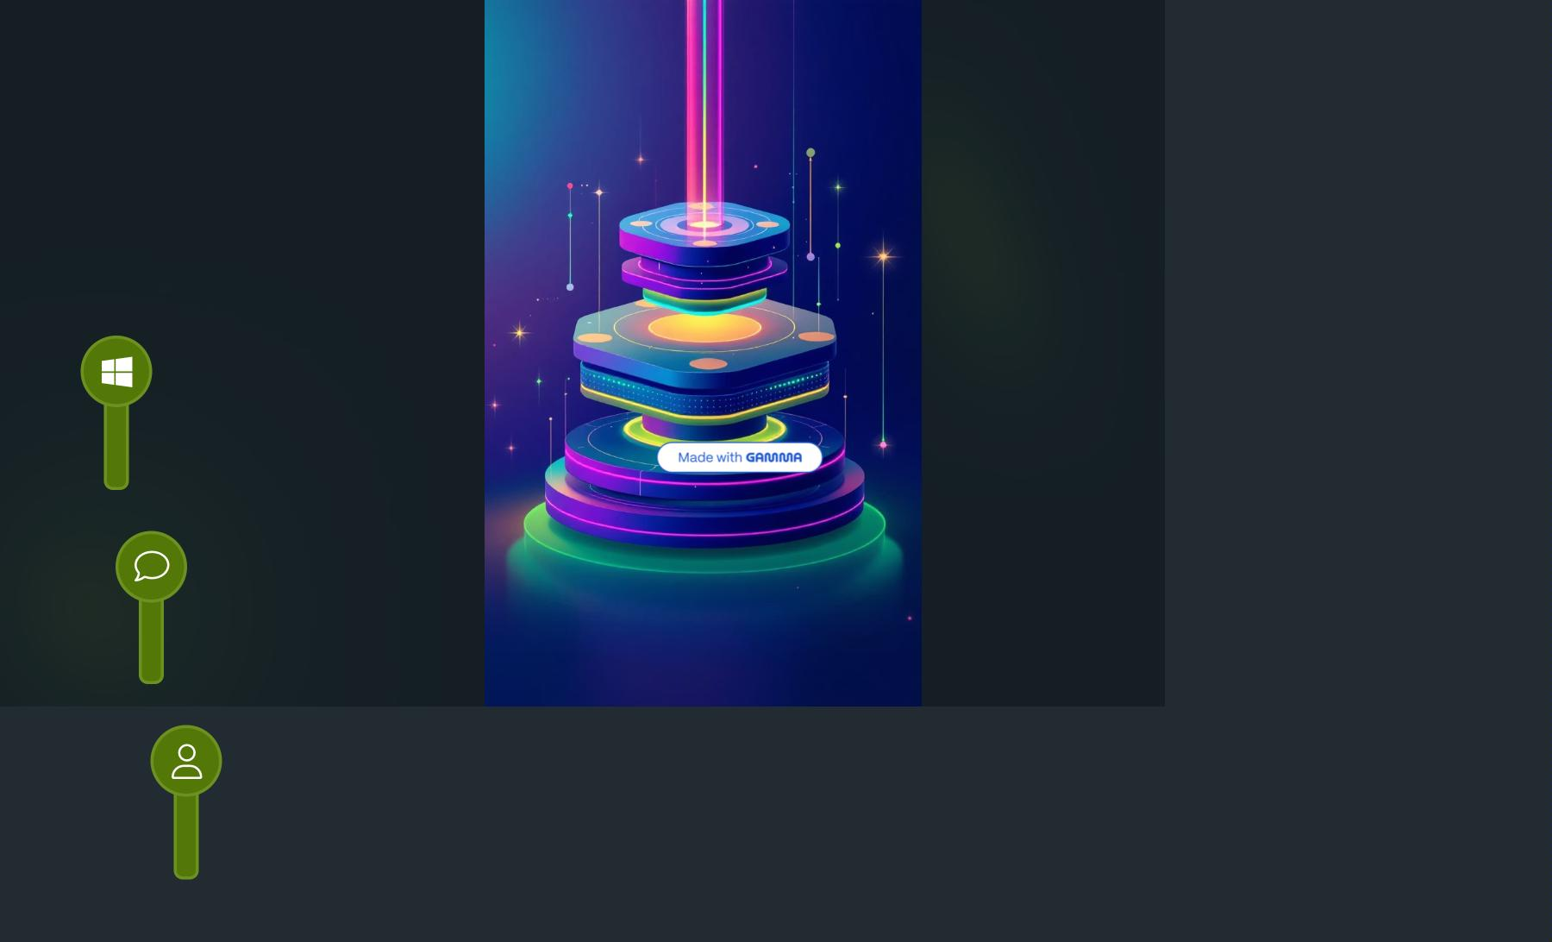
Three-Layer
Architecture
Summary
RHCOS Foundation
Container-optimized OS with CRIO runtime, kubelet service, and
ignition configuration.
Kubernetes Layer
Core orchestration with API server, scheduler, etcd, and controller
manager services.
OpenShift Layer
Enterprise features with OpenShift API, controller manager,
and OAuth authentication.

Slide 10
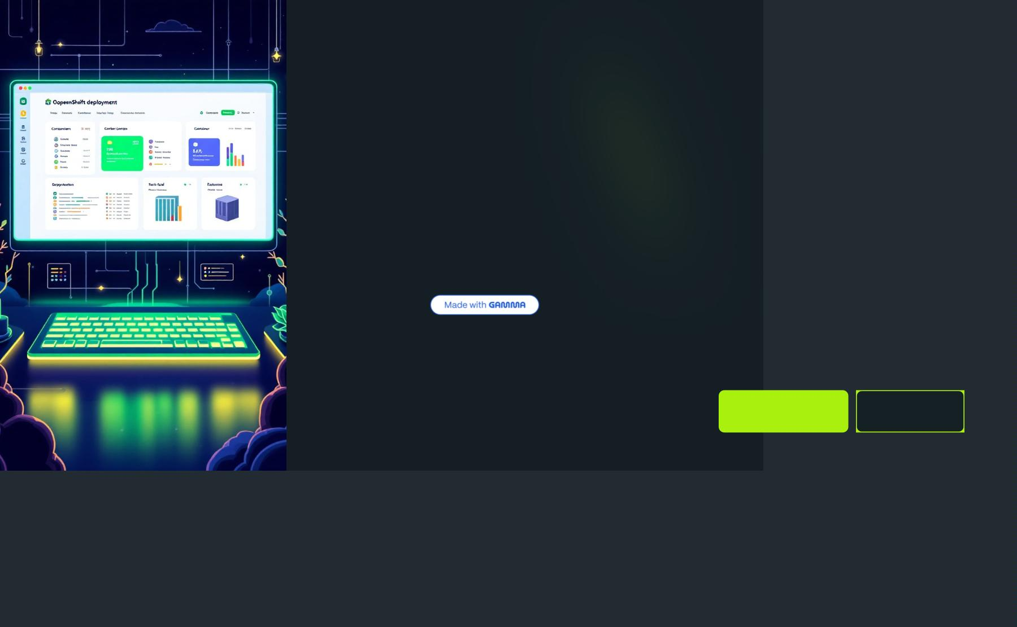
Ready to Deploy
OpenShift
Next
Steps">
Now that you understand OpenShift
EX280 Pra&
Watch V&
architecture, you're ready to learn
cluster installation and deployment
strategies.
The next lesson covers hands-on
OpenShift cluster setup and
configuration.

